Slide 1




02 March 2026
Econet AI Website Monthly Report Analysis

Slide 2


02 March 2026
This report aims to analyze the website's performance for February 2026, focusing on traffic, user flow, traffic sources, demographics, behaviors, and security.
What Is The Purpose Of This Report?
Key metrics
Traffic overview
Audience demographics
Behavior analysis
Acquisition channels
Conversion tracking
Areas Of Focus:

Slide 3
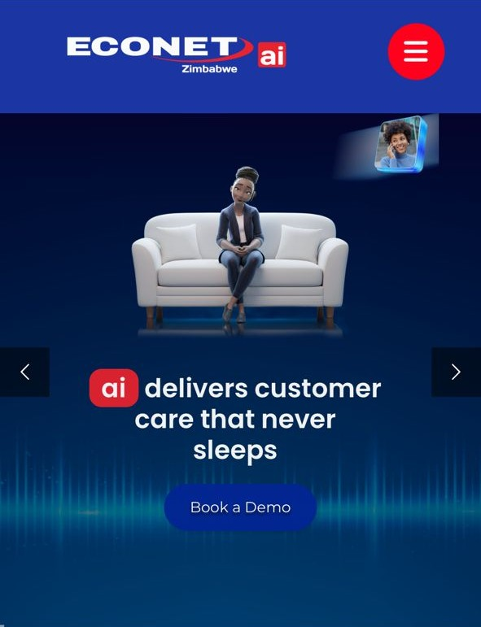
Summary
Performance of the website based on data insights
In the past month, the Econet AI Website attracted a total of 78 active users, with 76 being new users and 20 returning users, these are users that visited the site multiple time. The majority of users accessed the site through organic search (86 users), while smaller numbers came via direct Search(27). Zimbabwe contributed the highest traffic, with 55 users. On average, users engaged with the site for 1m 14s seconds per session.

Slide 4
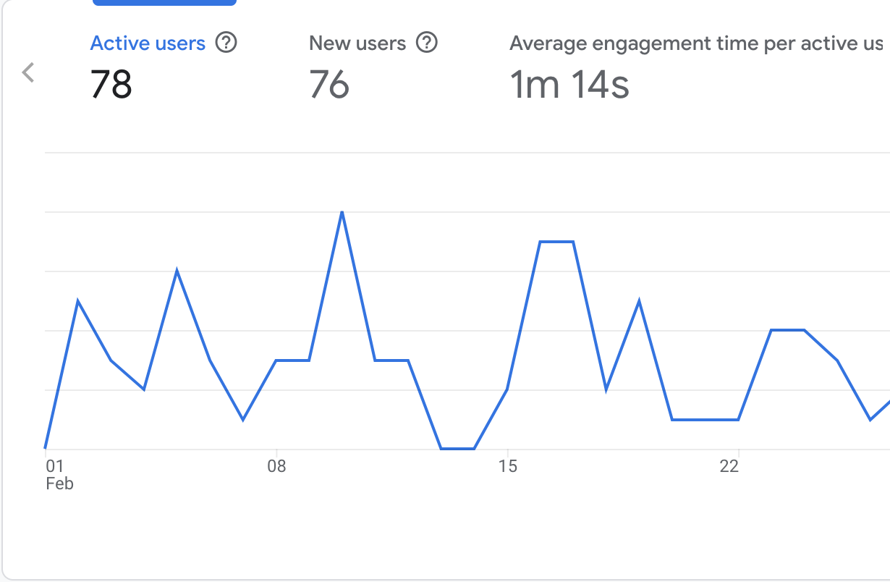
Site Overview
Emphasizing the important numerical data, the large line chart on the right displays the key metrics for the Econet AI website from the previous month.
It shows:
Users : 78 total users visited the site.
New Users : 76 new users, indicating most visitors were first-time visitors.
Average Engagement Time : Users spent an average of 1m 14s seconds on the site.

Slide 5
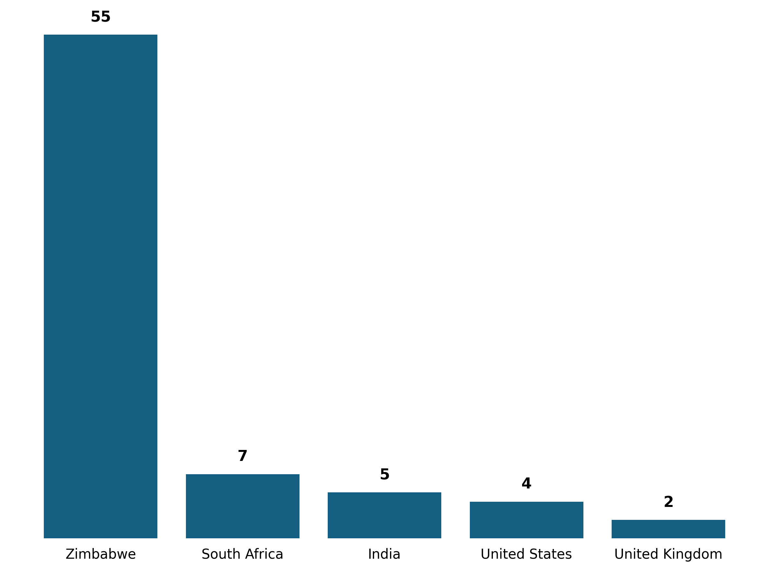
Demographic Overview
Most of the traffic is coming from Zimbabwe(55 users) , followed by South Africa with (7 users) then India with (5 users) and United States with (4 users) each.

Slide 6
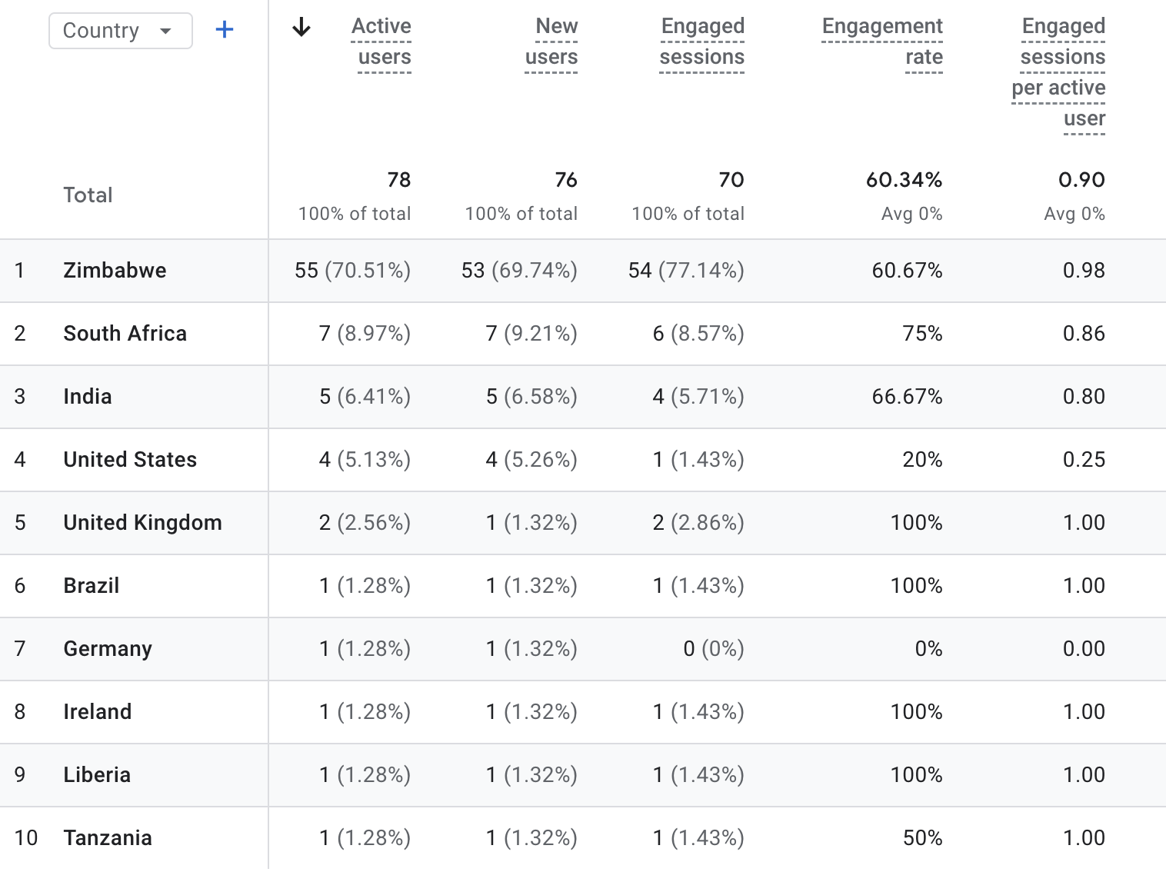
Demographic Overview

Slide 7
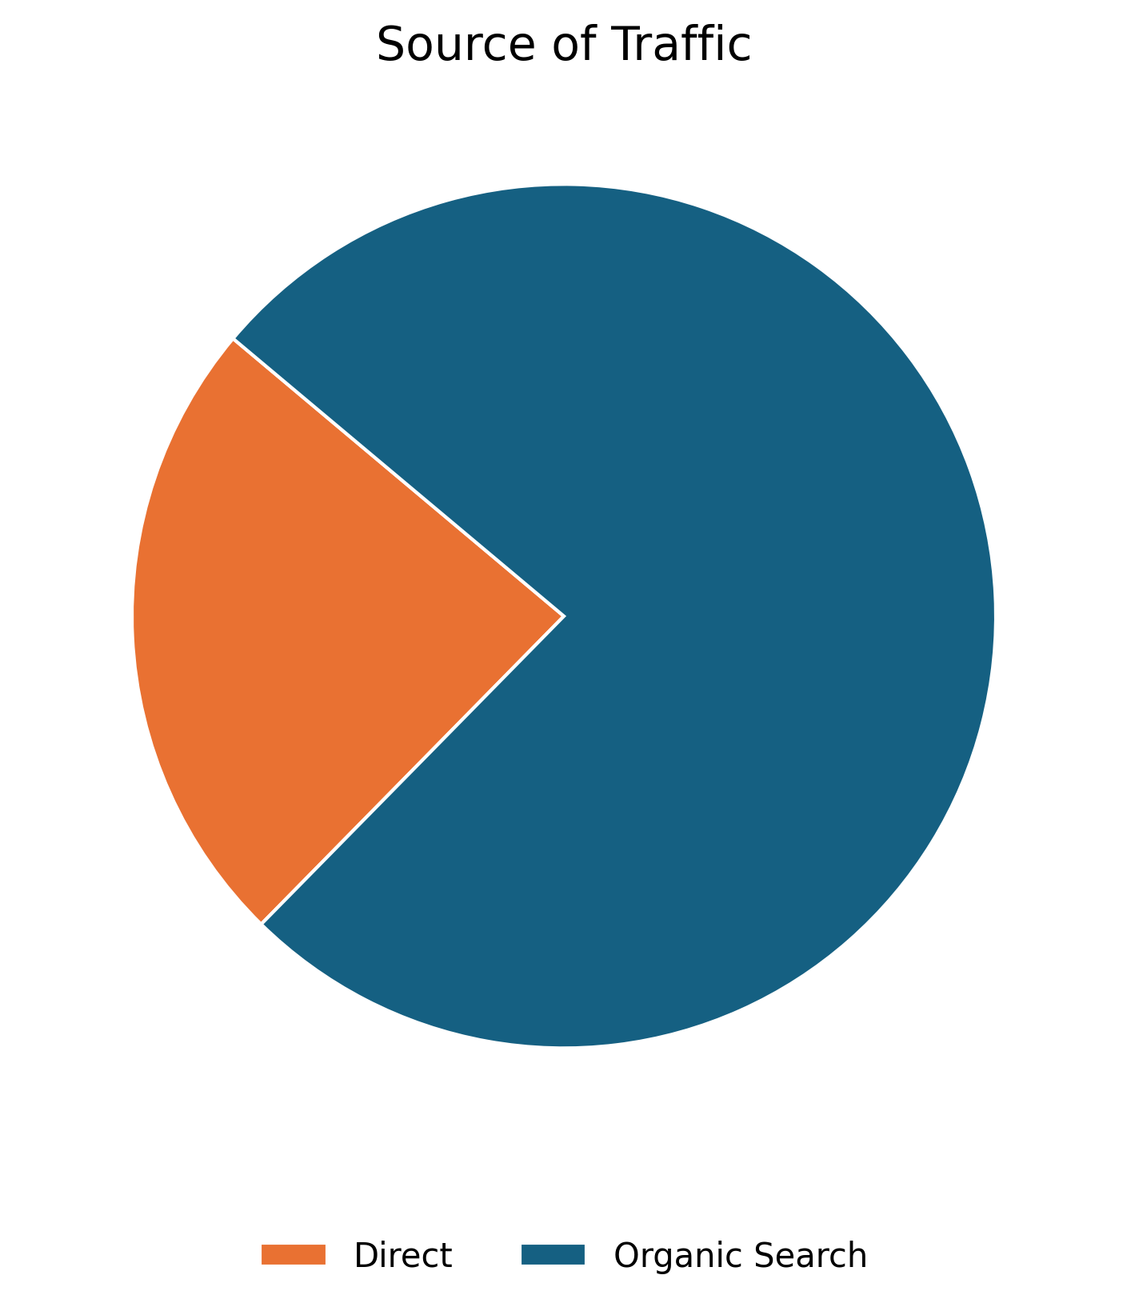
01 July 2025
User Acquisition
The data on this slide illustrates the various traffic channels bringing users to the Econet AI website. The pie chart reveals that the majority of traffic comes from Organic Search, which refers to unpaid search engine results generated based on their relevance to the user's query.
Source | Users
Organic Search | 61
Direct | 19

Slide 8
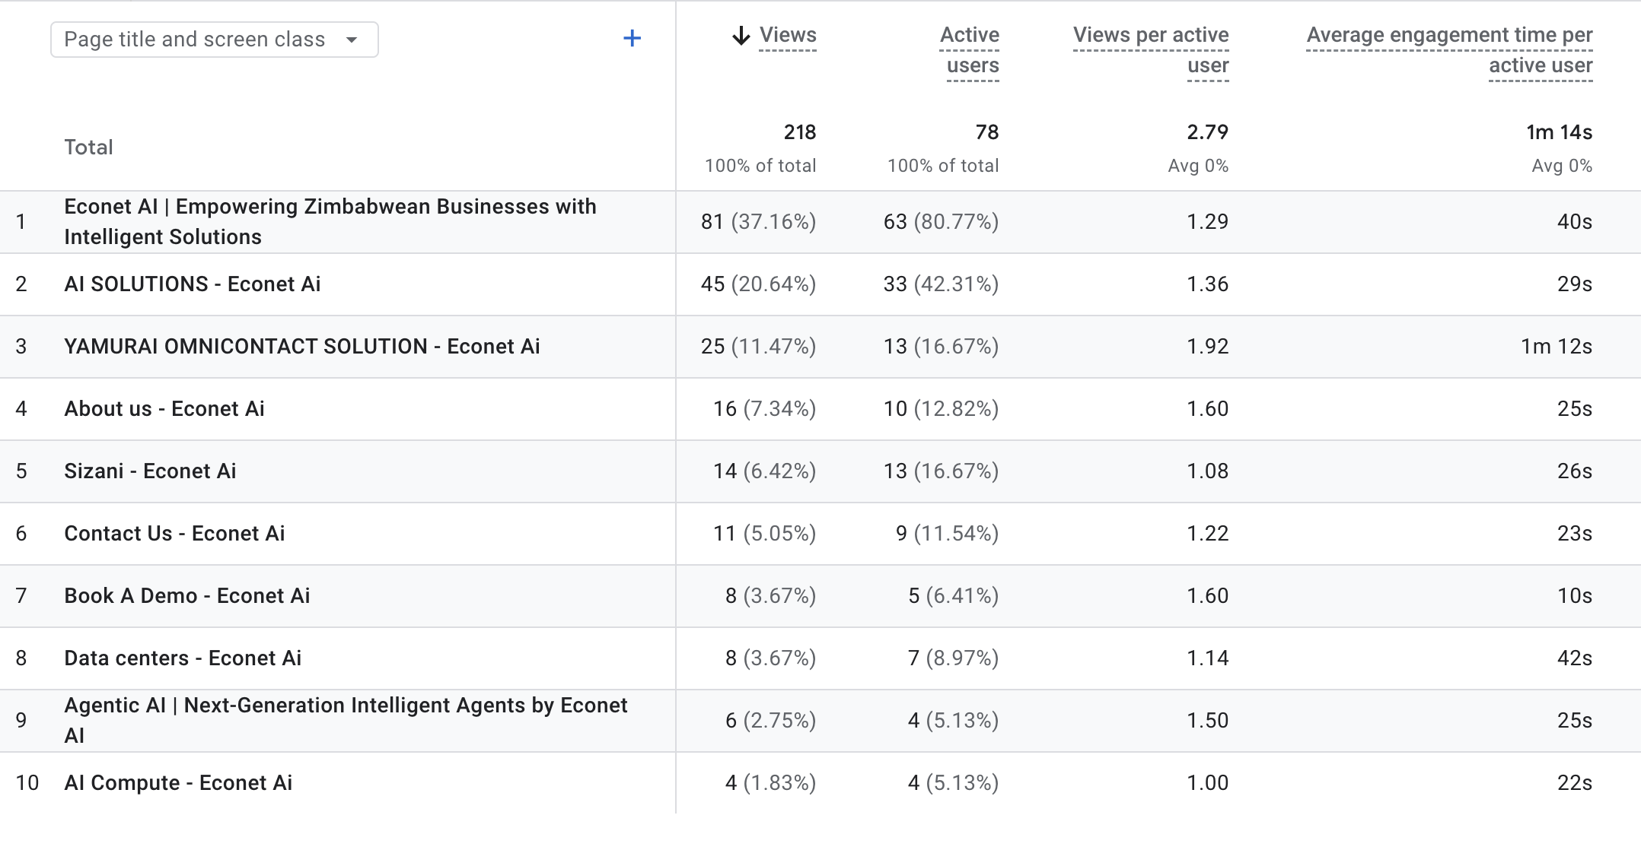

Pages Sessions
The table shows the top pages visited by users in the previous month

Slide 9
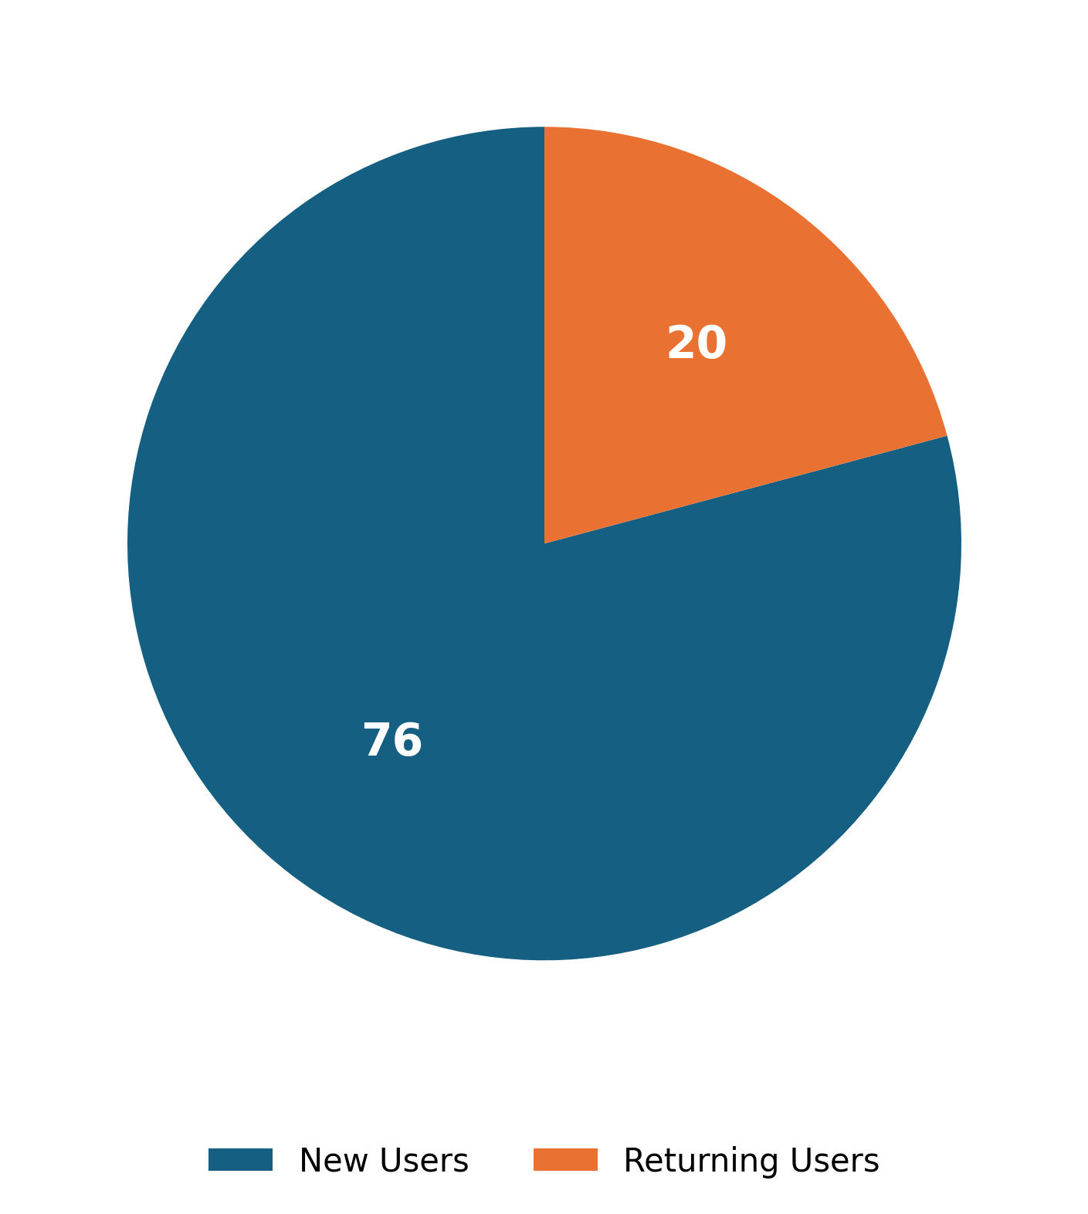
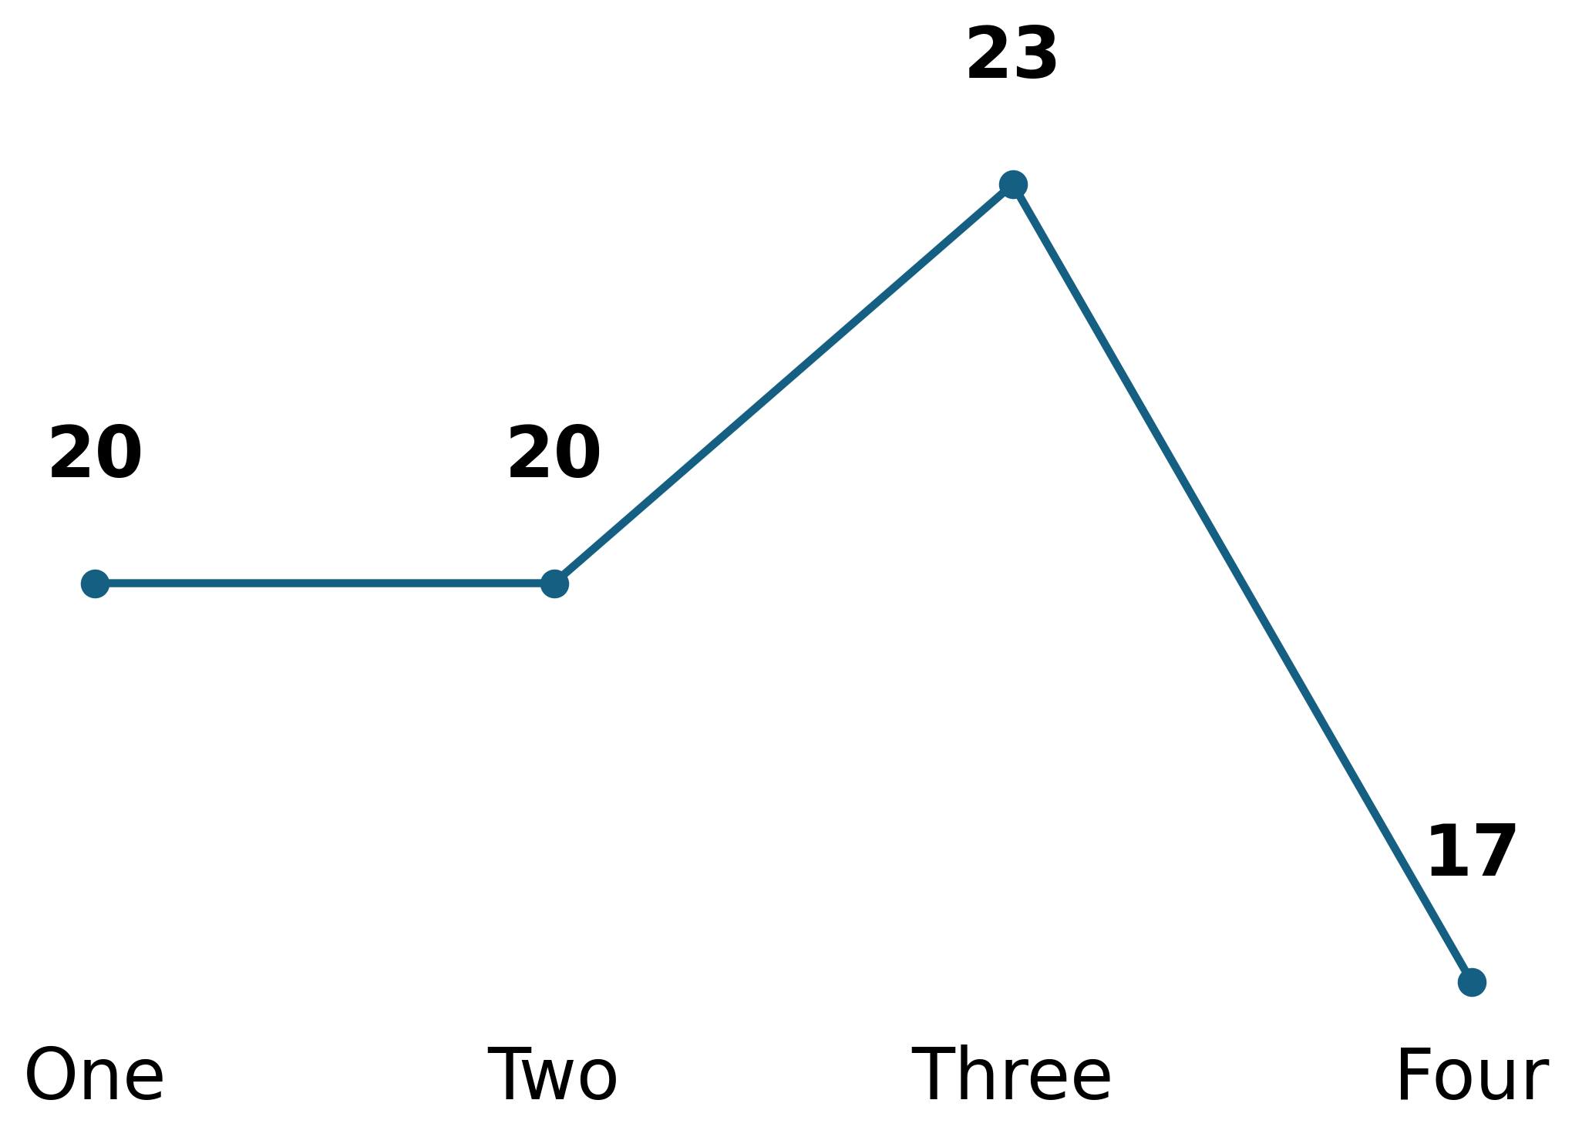
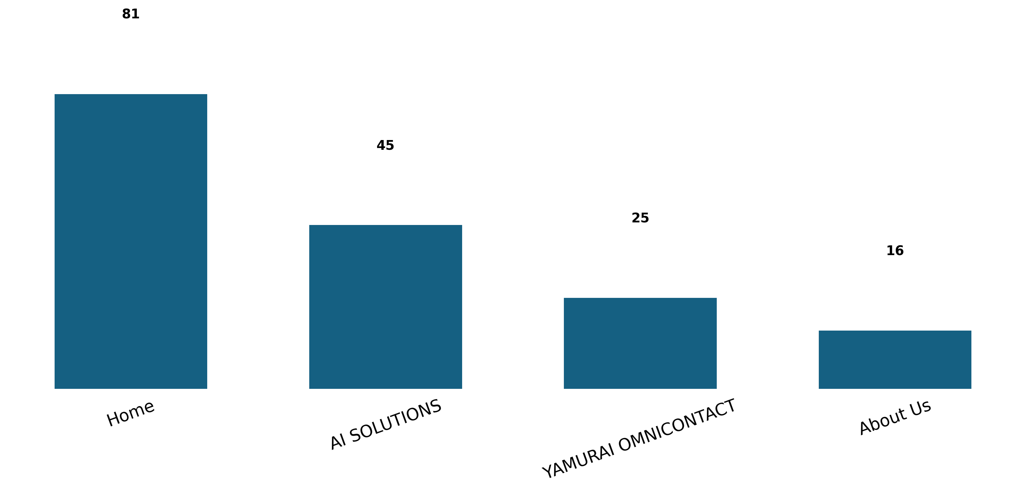
Behavior Analysis
Users
Engagement Rate Per Week
Page Views
Based on user interactions.
Measure user interaction.
Track page visits.

Slide 10
Recommendations
Based on data insights
1. Enhance User Engagement: Feature real-world demo videos and use-case stories for active tools like Yamurai OmniContact directly on the Home and AI SOLUTIONS landing pages.
2. Increase New Users: Deploy high-visibility promotional banners on the main Econet website that link directly to your specific AI SOLUTIONS page.
3. Increase Active Users: Have a section about the latest advancements happening in the AI field

